Slide 1
Math 22 Midterm 2 Review 10/23/19
Sec 7.1-7.5,7.8,8.1,10.1,10.2
Memorize your discussion section number

Slide 2
Identities that will be available on exam- if needed.

Slide 3
U-Substitution

Slide 4
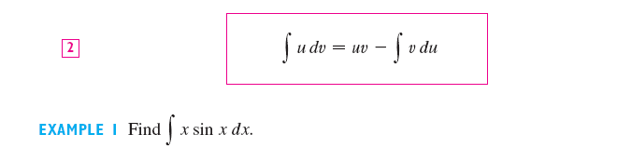
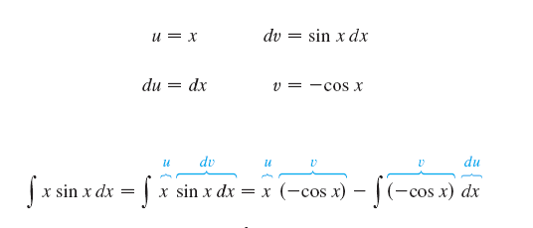
Integration by parts

Slide 5


7.2 Trigonometric integrals
Split the odd term
Factor out sec² θ for even sec
Factor out secθ tan θ for odd tan
For odd sec and even tan convert everything to sec and use the reduction formula.

Slide 6
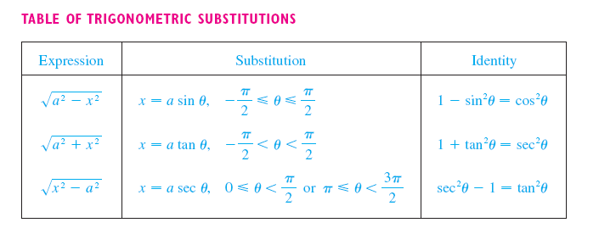
7.3 Trigonometric substitution

Slide 7
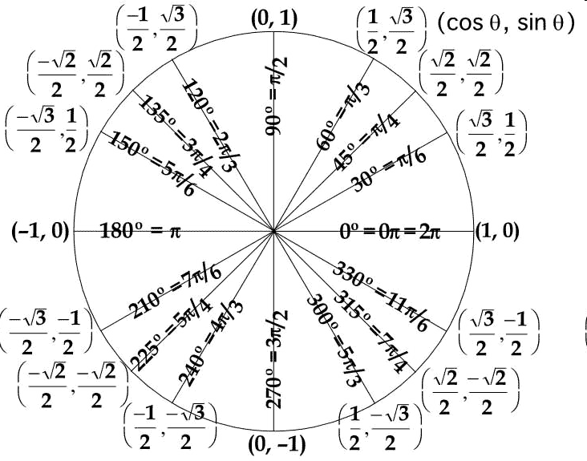
Review unit circle

Slide 8
Trig Subs

Slide 9
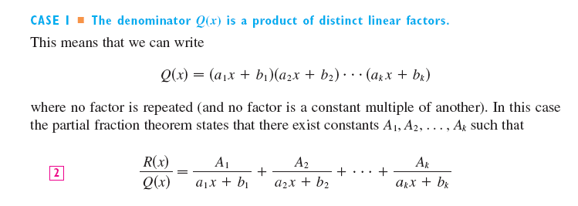
7.4 Partial Fractions

Slide 10
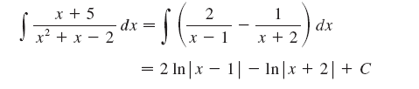
Partial Fractions

Slide 11
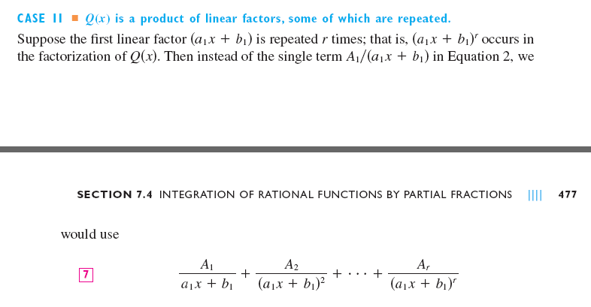
Partial Fractions
Practice long division for improper functions.

Slide 12
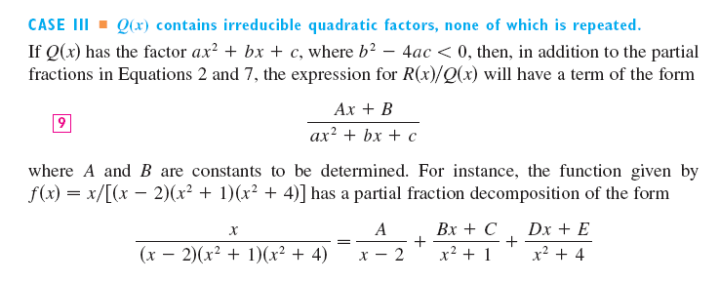
Partial Fractions

Slide 13
Irreducible forms.

Slide 14
Improper ratios

Slide 15
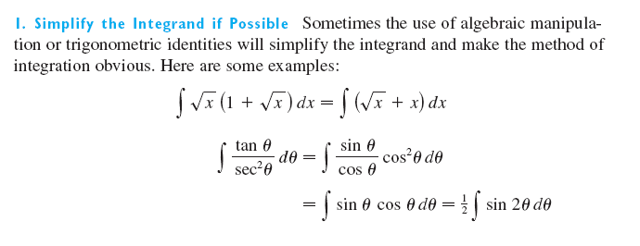
§ 7.5 Integration Strategy

Slide 16
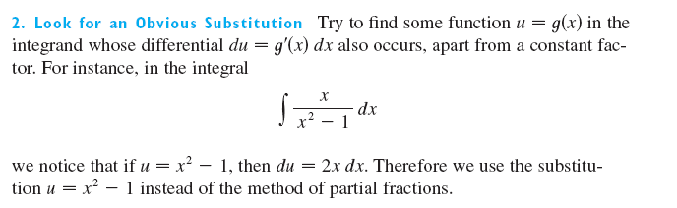

Slide 17
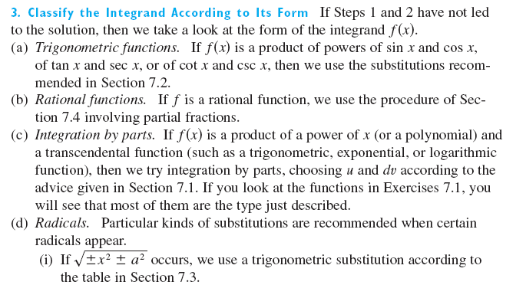

Slide 18
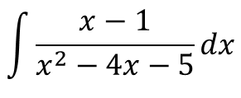
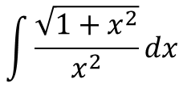
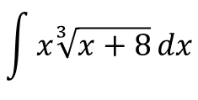
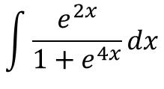
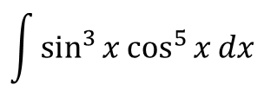
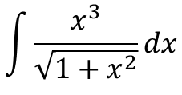
Examples
$$\int{x\sqrt[3]{x+8}}dx$$
$$\int{\frac{x^{3}}{\sqrt{1+x^{2}}}}dx$$
$$\int{\frac{x−1}{x^{2}−4x−5}}dx$$
$$\int{\sin^{3}{x\cos^{5}{x}}}dx$$
$$\int{\frac{e^{2x}}{1+e^{4x}}}dx$$
$$\int{\frac{\sqrt{1+x^{2}}}{x^{2}}}dx$$

Slide 19
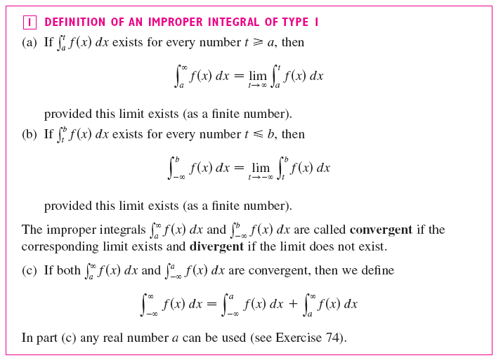
7.8 Improper Integrals.

Slide 20
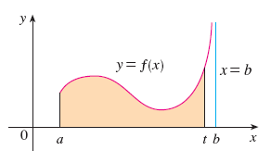
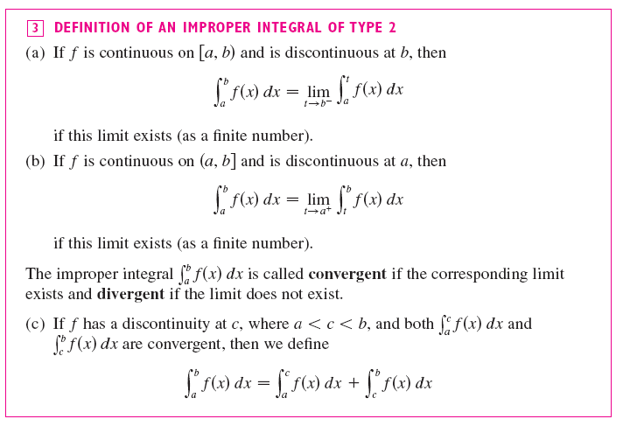

Slide 21
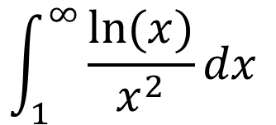
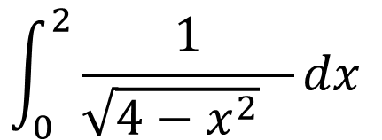
Improper integrals
Don’t skip limits
Solve improper integrals just like regular integrals and then take the limit at the end
Review L’Hospital’s Rule
$$\int_{1}^{∞}{\frac{ln⁡(x)}{x^{2}}dx }$$
$$\int_{0}^{2}{\frac{1}{\sqrt{4−x^{2}} }dx }$$

Slide 22
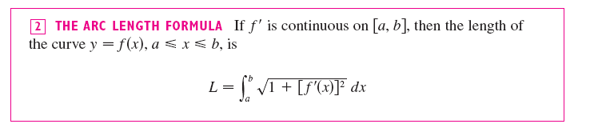
8.1 Arc Length
Find the arclength of y=x^(3/2) x= 0 to 1
Can you derive arc length formula?

Slide 23

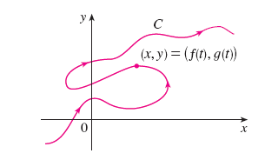
10.1 Parametric Equations

Slide 24
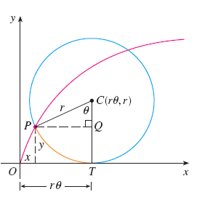
Know how to:
Plot parametric equations
Eliminate parameter
Create parametric equation from geometry

Slide 25
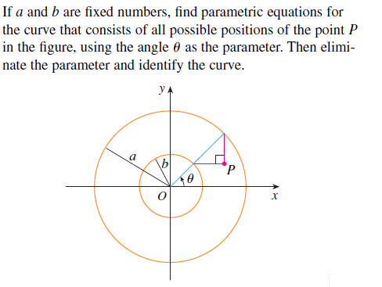
Equation of an Ellipse

Slide 26
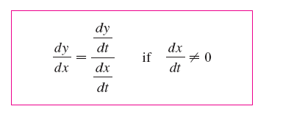
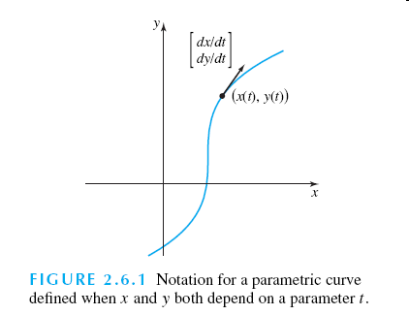
10.2 Derivatives and tangent vectors
You need to know how to determine the direction of a tangent vector.

Slide 27
Curve Plotting
Parametric trajectory C is described by
Find x, y intersects
Find tangent lines at (3,0)
Find points where tangent is vertical or horizontal
Concaves up or down
Sketch the curve

Slide 28
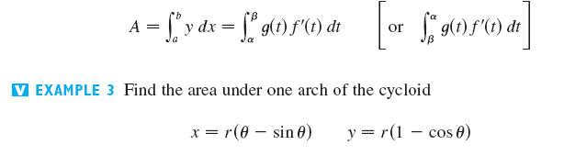
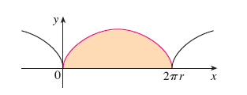
Area

